Slide 1
Computer Graphics: Line Drawing Algorithms
Scan Conversion Algorithms
(Midpoint Line)

Slide 2
7
6
5
4
Midpoint
3
2
0
1
2
3
4
5
6
7

Slide 4




(2, 4)
(2, 3)
(2, 2)

Slide 5



Slide 8
f(M) | Pixel chosen
f(M) > 0 | upper (NE)
f(M) ≤ 0 | lower (E)

Slide 9









Slide 10







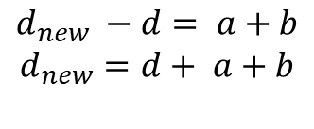

Slide 11












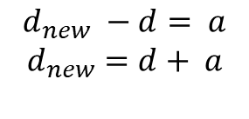

Slide 12
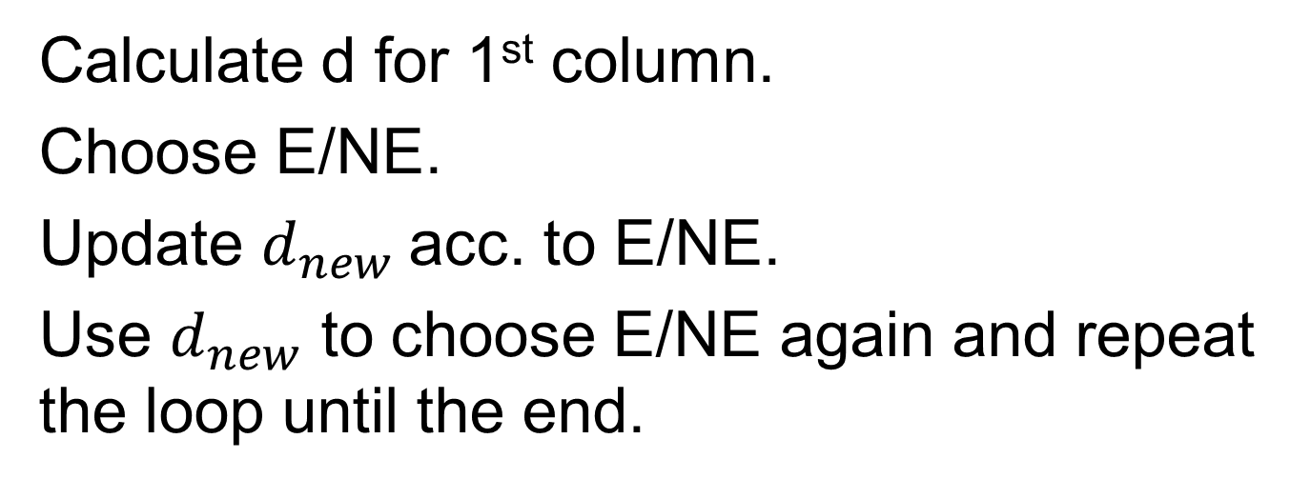

Slide 13
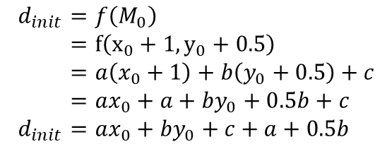
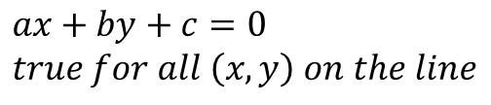



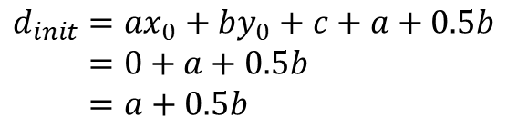
7
6
5
4
Midpoint
3
2
0
1
2
3
4
5
6
7

Slide 14





yes
no
no
yes
end

Slide 15

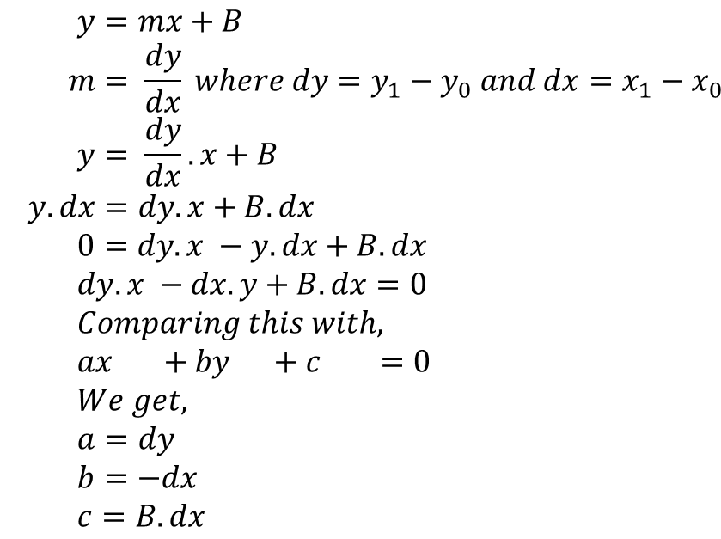



Slide 16
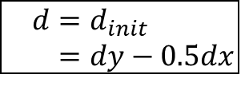
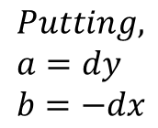
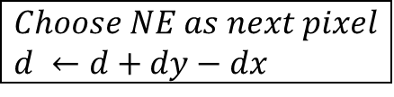
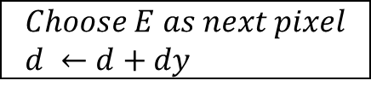
yes
no
no
yes
end

Slide 17
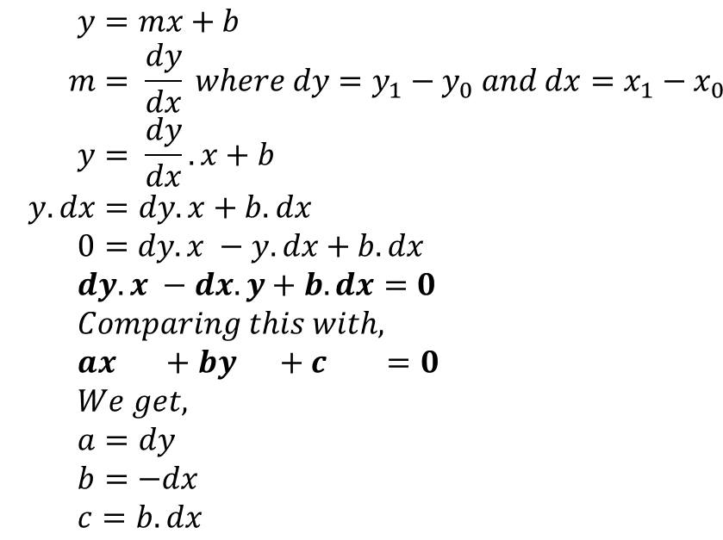
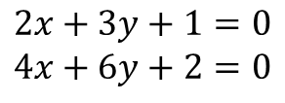

Slide 18
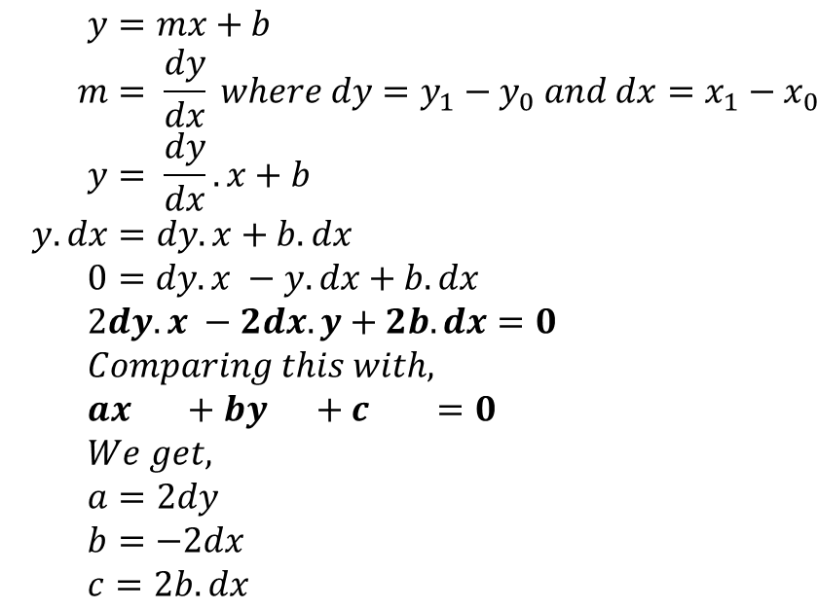

Slide 19
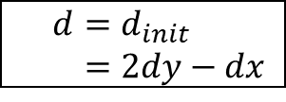
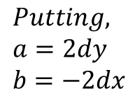
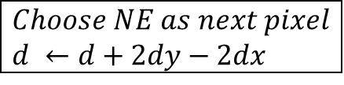
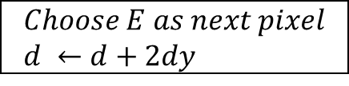
yes
no
no
yes
end

Slide 20
Algorithm
func MidpointLine(int x0, int y0, int x1, int y1, int value){
int dx, dy, incrE, incrNE, d, x, y;
dx = x1 -x0;
dy = y1 -y0;
d = 2 * dy - dx;
incrE = 2 * dy;
incrNE = 2 * (dy - dx);
x = x0;
y = y0;
WritePixel (x, y, value);
while (x < x1) {
if (d <= 0) {
//choose E
d = d + incrE;
x = x + 1;
}
else {
//choose NE
d = d + incrNE;
x = x + 1;
y = y + 1;
}
WritePixel (x,y, value) //The selected pixel closest to the line
}
}

Slide 21
Reference:
Computer Graphics: Principles and Practice: John F. Hughes, James D. Foley, Andries van Dam, Steven K. Feiner (2nd Edition)
Chapter: 3.2

